Slide 1
Meetup Scheduler
by Emma Jauregui and Jay Vang

Slide 2

Objectives and Goals
Create a web application
That can find free time slots for students within a group
Learn
Linux
Servers
Websites
Free and open libraries, modules, frameworks
Svelte
Development

Slide 3



Technologies
HTML, CSS, JS - Languages
Npm(Node) - package manager
Svelte - Frontend framework
Sqlite3 - Database
Libraries, modules, etc.
bcrypt - password hashing
tailwindCSS
date-fns - dates for calendar
Github - Source control
Github Desktop - GUI
VsCode - Coding
Linux or Windows

Slide 4
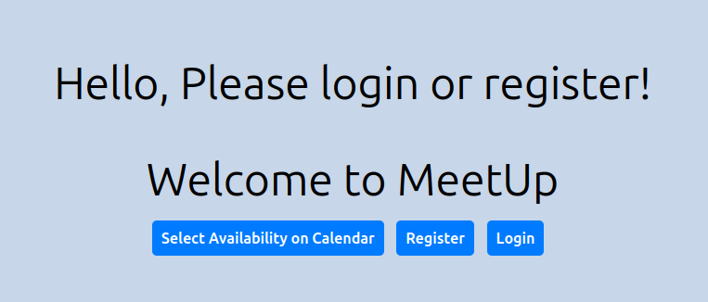

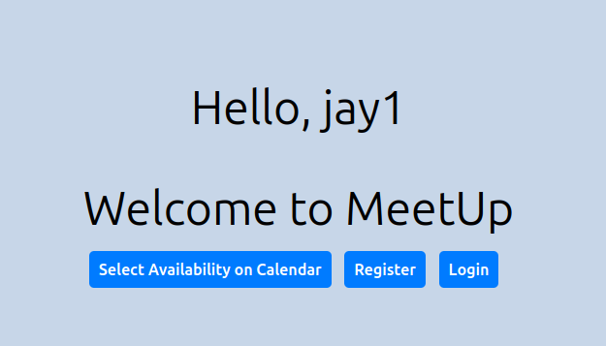
Home Page
Simple and concise navigation
If the user is not logged already, will prompt them to do so
Will greet the user by their username if logged in

Slide 5
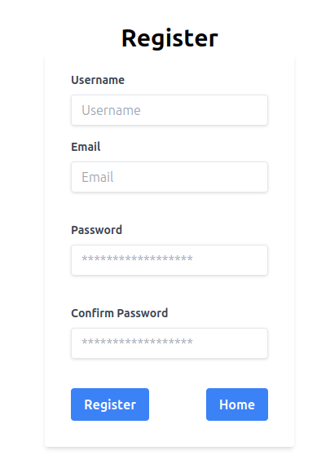
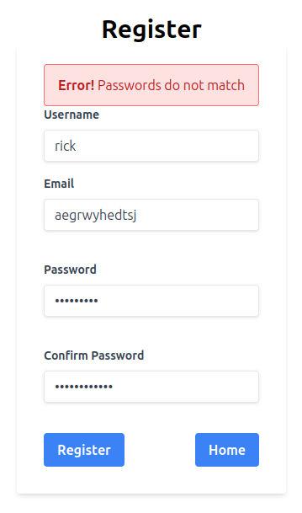
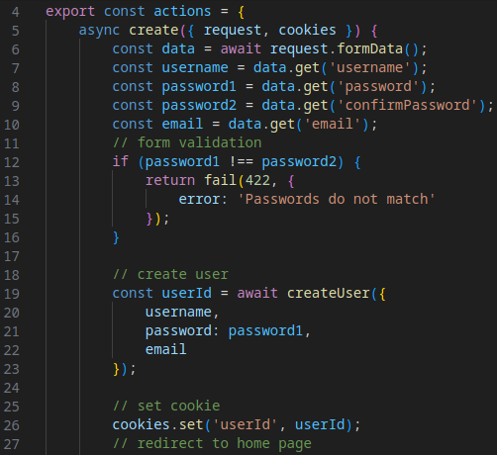
Register
Can store user’s username, email, and passwords
Error-handling
Email
Password
Does not actually send an email, but will store it as data.
Requests data from html forms and creates it in SQLite3
JS

Slide 6
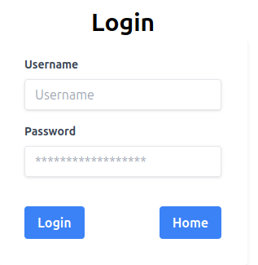
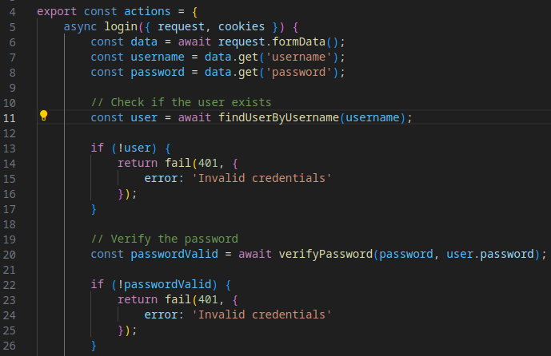
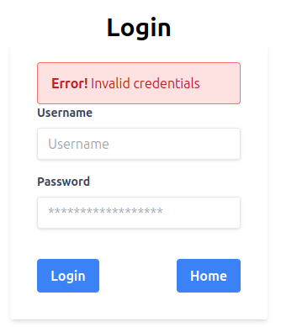
Login
JS
Will take user to homepage if successful
Error-handling
Incorrect info
Fetches data from the html forms, then sends it over to backend DB and checks

Slide 7

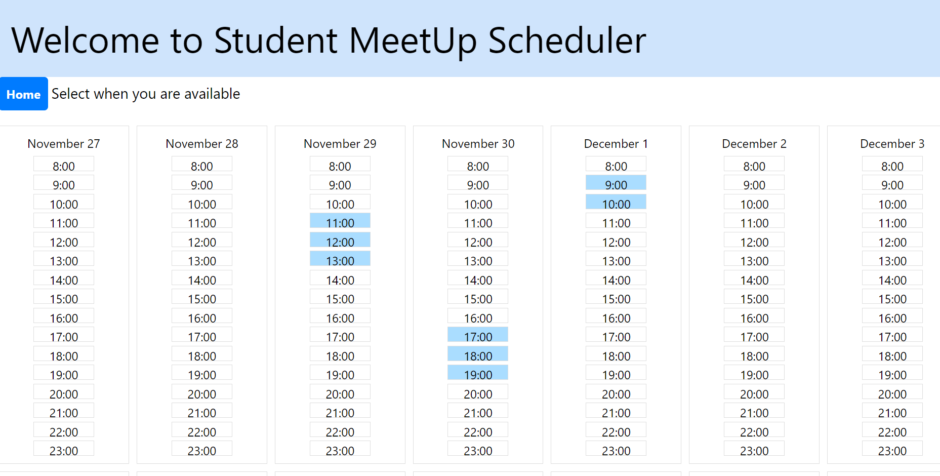
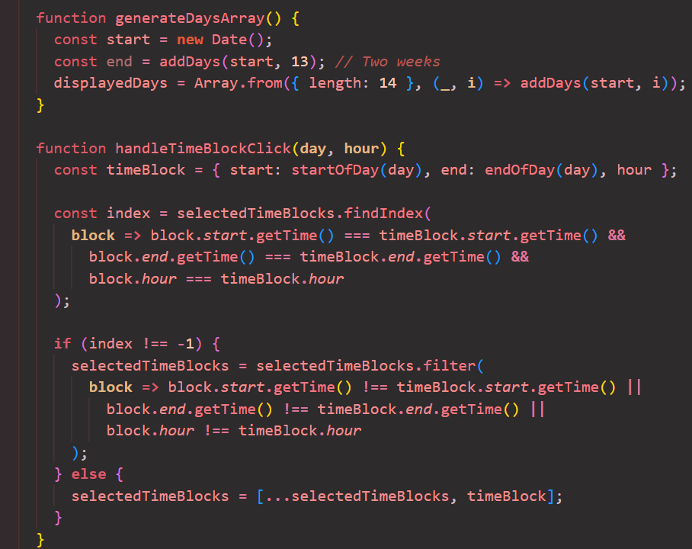
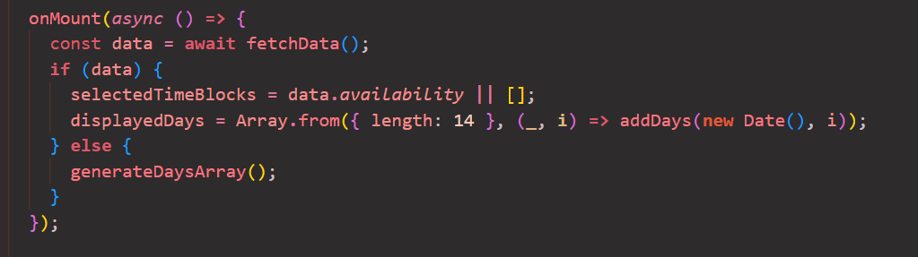
Calendar
How it Works:
Generate days/timeslots based on array using date-fns
Render a grid of days to reformat and make presentable
Clicked timeslots handled in an array (with start and end point)
(Try to) Send data to backend
Utilized mount from svelte

Slide 8
Unfunctional Calendar (pseudocode snippet)
The Issues:
Inexperience with backend
Difficulty applying logic/theory with framework
Intention:
Store available/selected timeslots into DB, tied with user’s ID
Once request is made, send user’s availability data
Make comparison between user’s availability to generate best timeslots/days to meet
(continued):
function sendDataToBackend():
try:
const userId = ?
const response = sendBackendData(userId, selectedTimeBlocks)
const data = response.json()
logSuccess('Data successfully sent to backend:', data)
catch error:
logError('Oops. Error sending data to backend:', error)
Implementation:
function fetchData():
try:
const userId = ?
const response = fetchBackendData(userId)
const data = response.json()
return data
catch error:
logError('error fetching data:', error)
return null

Slide 9
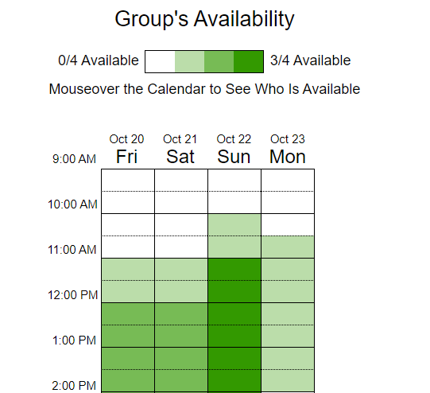

Closing
How We Can Improve:
Figure out/Fix the calendar functionality
Implement the logic to compare other user’s schedules side-by-side
Implement a visual representation of the overlapping timeslots/days
Implement way to set up “groups” based on a larger groups similar schedules
Important Takeaways:
We Learned A lot!
something like this ^

